Slide 1
INTRODUCTION TO KU INNO DESIGN GUIDE
June 26, 2026
Melanie Povlitzki & Maria Shubra Ovesen

Slide 2
KU INNO DESIGN GUIDE
WHY?
GUIDING PRINCIPLES
COLOR PALLETTE
TEXT STYLE
LOGO PLACEMENT
FIGURE STYLE
TABLE STYLE
ICON LIBRARY
PHOTO STYLE

Slide 3
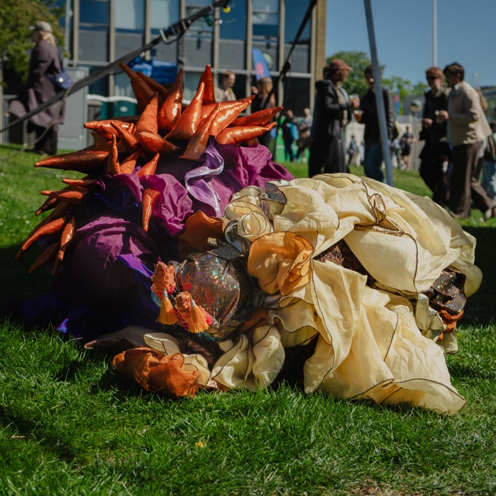
WHY?
1
Consistency
2
Cohesion (common brand)
3
Clarity

Slide 4
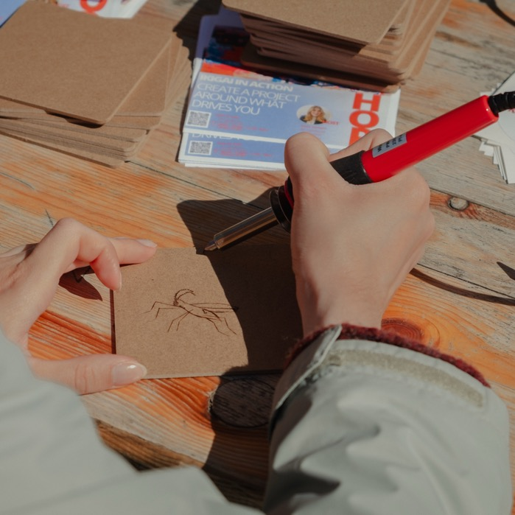
GUIDING PRINCIPLES
1
Show, don’t tell!
More weight on pictures and visuals.
2
Less is more - keep it simple.
Extra text should be added in notes.
3
Audience focused.
What do you want them to remember?
4
Don’t overcrowd your slides.
White space between elements
makes your slides easier to read.

Slide 5
COLOR PALLETTE
Red-orange
#dB3B0A
We use selected colors from KU’s brand guide.
This combination ensures a strong connection to KU’s brand, while enabling KU INNO to distinguish itself visually as a department.
Light blue
#b7d7de
Champagne
#fefaf2
Dark blue
#122947
KU red
#901a1E
Dark grey
#3d3d3d

Slide 6
COLOR USE
Red-orange text on champagne background
It’s important to ensure ample contrast when combining colors to ensure readability.
Dark blue text on champagne background
Good
contrast
Red-orange text on light blue background
Dark blue text on light blue background
Poor
contrast
Dark blue text on red-orange background
Champagne text on
red-orange background

Slide 7
THE COLOR PURPLE
KU Lighthouse as an innovation center is visually indicated via the use of the color purple, along with a few other visual elements.
Don’t use this color unless you’re part of KU Lighthouse. A design guide for KU Lighthouse specifically will follow.

Slide 8
TEXT STYLE
EXAMPLE:
In powerpoint, we use the font type Open Sans - a sans serif KU font
Use Regular, Semibold or Bold depending on hierarchy. Text hierarchies are built into the layout options.
*As a general rule, use the same text color across text hierarchies. Use a maximum of 3 different colors on the same slide, including text, background and graphics.
HEADINGS
SUB-HEADINGS
Semibold, CAPS, 52 pt.
Body text
Regular, CAPS, 24 pt.
Regular, Sentence case, 24-18pt.
Line spacing: Multiple (1.2)

Slide 9

LOGO PLACEMENT
KU’s logo must be visible on all slides.
On most slides, placement should be at the top-left corner with a thin line underneath.
On title pages and slides with large quotes/statements the logo is placed in the bottom-right corner.
*Logo placement is automatically built into most slide layouts – however, due to technical issues in powerpoint the logo must be manually placed when full-slide pictures are used.
Use these logos for copy/pasting on top of pictures. DO NOT CHANGE SCALE!

Slide 10

LOGO PLACEMENT
On dark backgrounds (red-orange, dark blue , KU red or dark-colored whole-slide pictures), a negative (white) version of the logo is used to ensure visibility.
Use these logos for copy/pasting on top of pictures. DO NOT CHANGE SCALE!

Slide 11
FIGURE STYLE
THIN OUTLINE
One option is to use a thin outline (line weight 1.5) along with text and/or icons to create figures in ppt.
Set shapes to no fill and match the text and line colors so they are the same.
*This style works best for shapes on light backgrounds (champagne & light blue).
EXAMPLE
UNIT 1
UNIT 2
UNIT 3

Slide 12
FIGURE STYLE
SOLID SHAPES
THIS
Another option is to create figures with solid shapes. This provides a more bold look.
*This style works best for shapes on dark backgrounds (red-orange & dark blue).
AND THE
OTHER THING
THAT

Slide 13
FIGURE STYLE
DO’S & DON’T’S
Place text in circles…
Or rectangles…
But don’t use rounded corners!
Use
flat shapes
Shapes can be solid
Or outlined
(line weight 1.5)
But not both!
Without drop shadow

Slide 14
TABLE STYLE
Copy/paste and
adjust rows/columns accordingly
FULL PAGE TABLE
HEADER | HEADER | HEADER | HEADER
Content | Content | Content | Content
Content | Content | Content | Content
Content | Content | Content | Content
Content | Content | Content | Content

Slide 15
TABLE STYLE
SMALL TABLE
When inserting a table, use the formatting options below or copy/paste the table to the right and adjust columns & rows accordingly
Shading: No fill (same color as background)
Borders: All borders
Line thickness: 1.5
Pen color: same as line color
Text alignment: left side, middle
Text style: OpenSans (regular or bold)
 | Column 1 | Column 2 | Column 3
Row 1 | Content | Content | Content
Row 2 | Content | Content | Content
Row 3 | Content | Content | Content
Row 4 | Content | Content | Content
Row 5 | Content | Content | Content

Slide 16
Copy/paste and
adjust rows/columns accordingly
TABLE STYLE
FULL PAGE TABLE – RED-ORANGE
HEADER | HEADER | HEADER | HEADER
Content | Content | Content | Content
Content | Content | Content | Content
Content | Content | Content | Content
Content | Content | Content | Content

Slide 17
TABLE STYLE
RED-ORANGE ON CHAMPAGNE BACKGROUND
When inserting a table, use the formatting options below or copy/paste the table to the right and adjust columns & rows accordingly
Shading: No fill (same color as background)
Borders: All borders
Line thickness: 1.5
Pen color: same as line color
Text alignment: left side, middle
Text style: OpenSans (regular or bold)
 | Column 1 | Column 2 | Column 3
Row 1 | Content | Content | Content
Row 2 | Content | Content | Content
Row 3 | Content | Content | Content
Row 4 | Content | Content | Content
Row 5 | Content | Content | Content

Slide 18
ICON LIBRARY
RED ORANGE
We use outlined-style icons drawn with thin, (3 pt.) lines.
Use red-orange icons on
cream-colored background.
Copy paste icons to use in figures and diagrams.
*More icons will be added to the library as they’re created.

Slide 19
ICON LIBRARY
RED ORANGE

Slide 20
ICON LIBRARY
DARK BLUE
We use outlined-style icons drawn with thin, (3 pt.) lines.
Use dark blue icons on light blue background.
Copy paste icons to use in figures and diagrams.
*More icons will be added to the library as they’re created.

Slide 21
ICON LIBRARY
DARK BLUE

Slide 22
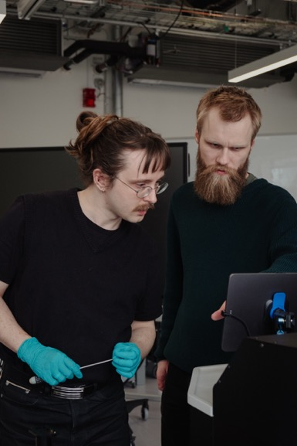
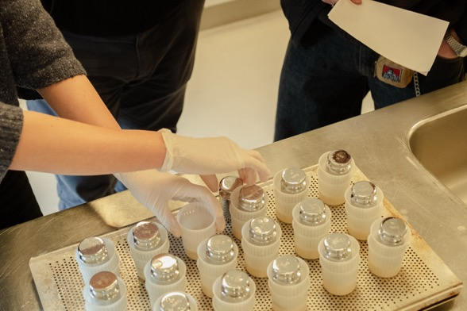
PHOTO STYLE
NEW PHOTO LIBRARY - 2026
New photos have been taken to better represent the innovation taking place at KU across different academic environments. Use these photos whenever possible.
Style: Warm, people-centered, dynamic
Link to KU INNO
photo library
Nye fotos 2026:
https://alumni.sharepoint.com/:f:/r/sites/UCPH_KUINNO/Shared%20Documents/Kommunikation%20-%20Communication/3.%20Foto%20og%20video/Nye%20fotos%202026?csf=1&web=1&e=Lm2XAu

Slide 23
THANK YOU

